Slide 1
Digital System

Slide 2

introduction
System = set of related components that work to achieve a goal
Digital System = System in which signals have finite number of discrete values

Slide 3
Digital systems are used to store, process and communicate information in digital form
Applications = process control system, communication system, digital instrument
Types =
Combinational Circuit
Sequential Circuit

Slide 4
Characteristics –
Data is represented as a vector of binary variables
Provide accuracy in terms of number of bits used to represent a variable
Data representation is suitable for error detection and error correction
Generates square waveform
Digital signal is represented by two possible voltages on a wire –
0 volts i.e. low logic and 5 volts i.e. logic high

Slide 5
Widespread use of Digital System –
Digital Circuit operates in one of two states – ON / OFF only
There are only few basic operations which are easy to understand
Requires Boolean Algebra which is very easy to learn
Large number of ICs are available to perform various operations

Slide 6
Number System
System of writing to express numbers
Types –
Decimal Number System
Binary Number System
Octal Number System
Hexadecimal Number System
Signed Binary Number –
Sign Magnitude Representation
One’s Complement Representation
Two’s Complement Representation

Slide 7
Binary Arithmetic –
Binary Addition
Binary Subtraction
Binary Multiplication
Binary Division
2’s Complement Arithmetic –
Addition / Subtraction using 2’s Complement

Slide 8
Code
Various binary codes used to represent data (numeric, alphabets or special characters)
Examples –
Numeric Code –
Straight Binary Code
Natural BCD
Excess-3 Code
Gray Code
Alphanumeric Code –
Extended BCD Interchange Code
American Standard Code for Information Interchange

Slide 9
Basic Digital Circuits
Logic Gates – building blocks of any digital system
AND
OR
NOT
EX-OR
NAND
NOR
EX-NOR

Slide 10
Boolean Algebra
Boolean Algebra used to analyze and simplify the digital circuits
Boolean Laws –
Commutative Law
Associative Law
Distributive Law
Idempotent Law
Complement Law
Absorption Law
De’Morgan’s Law

Slide 11
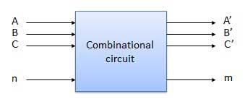
Combinational Logic circuit
Contain different types of Logic Gates
Output is determined from present combination of inputs
Example –
Adder / Subtractor
Decoder / Encoder
Multiplexer / De-Multiplexer

Slide 12
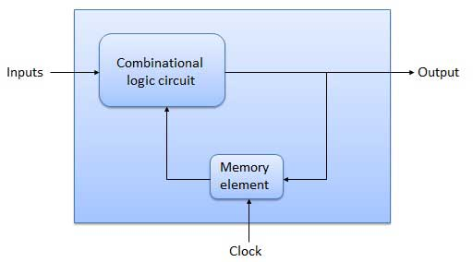
Sequential Logic circuit
Contain different types of Logic Gates
Output is determined from present combination of inputs as well as previous output
Example –
Flip-flop
Shift Register
Digital Counters

Slide 13
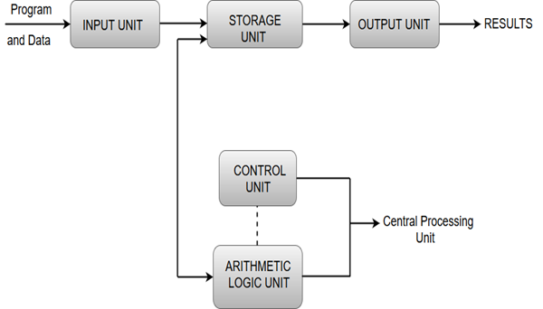
Functional Units of digital system
A computer organization describes functions and design of various units of digital system

Slide 14
Von Neumann Architecture
Basic Instruction Cycle
Memory Hierarchy

Slide 15
Microprocessor
IC – capable of performing arithmetic and logic operations
8086 microprocessor –
Functional Block Diagram
Instruction Format
Addressing Modes
Segmented Memory and Interleaved Memory

